Slide 1
Divi Site Tutorial
How to add a new page

Slide 2
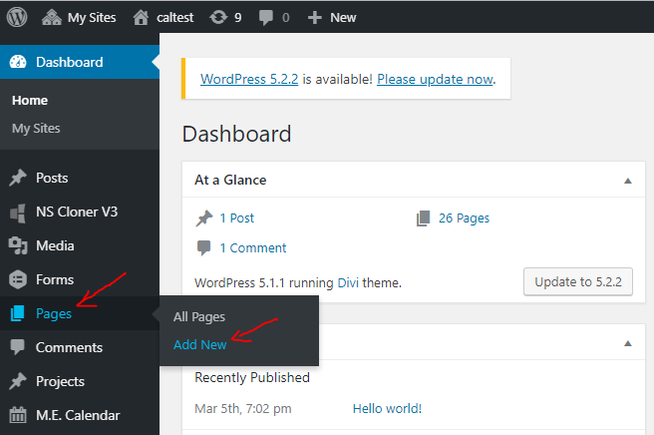
Once logged in – Click on “Add new” under “Pages” from the left menu area.

Slide 3
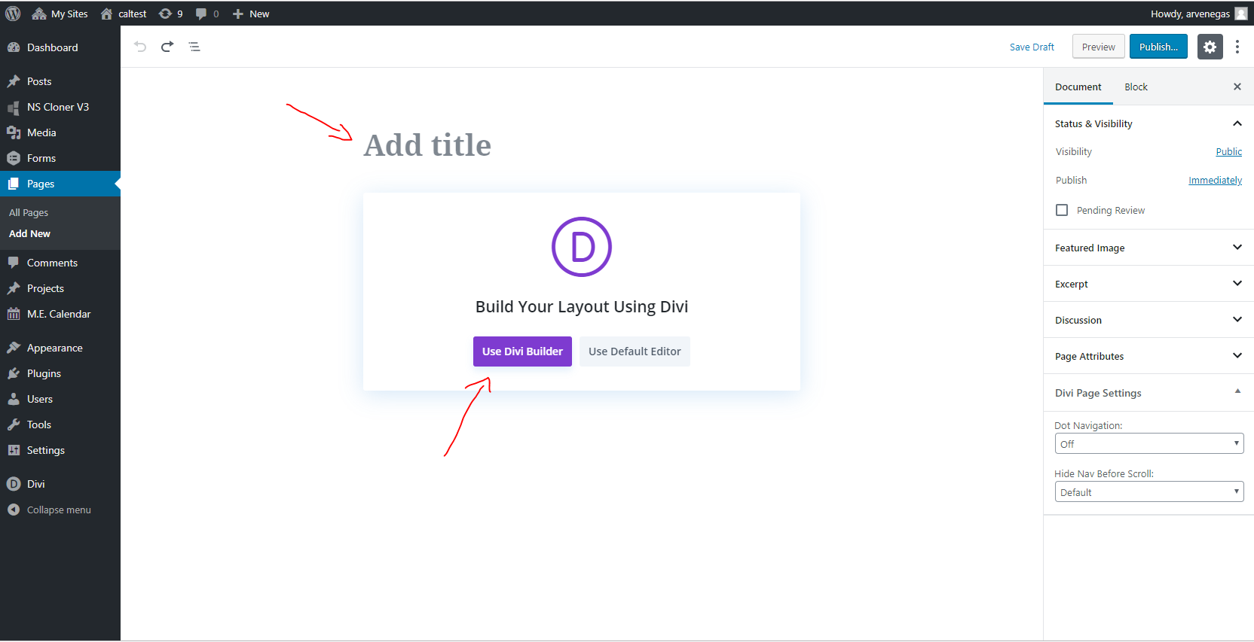
You will see this page. Please enter a title and click on “Use Divi Builder”

Slide 4
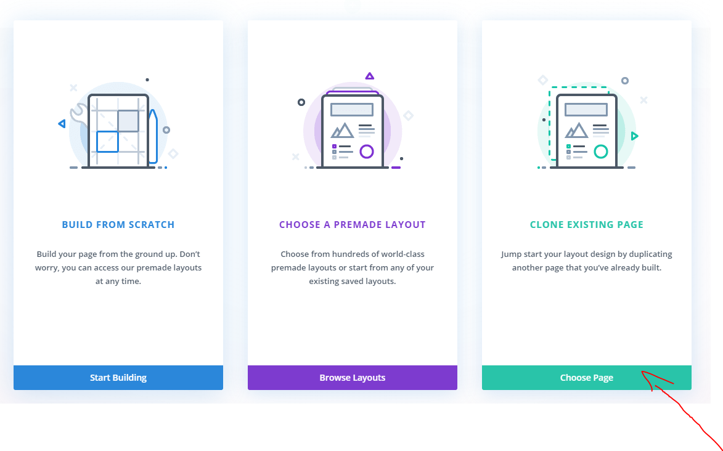
Next, you will be greeted with these options. Please click on the third one “Clone Existing Page”

Slide 5
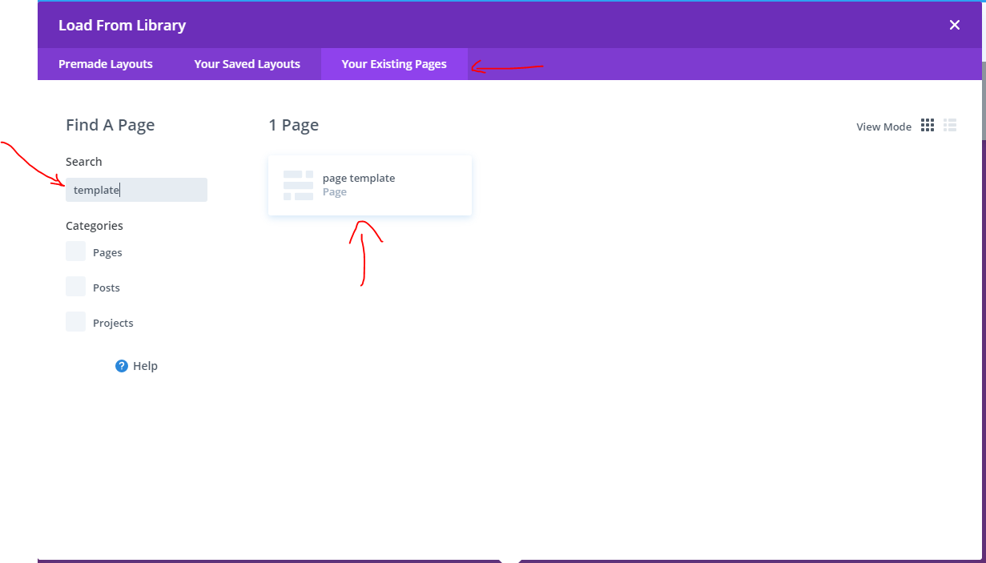
From here – click on the third tab “Your Existing Pages” and search for “template” then click on “page template”

Slide 6
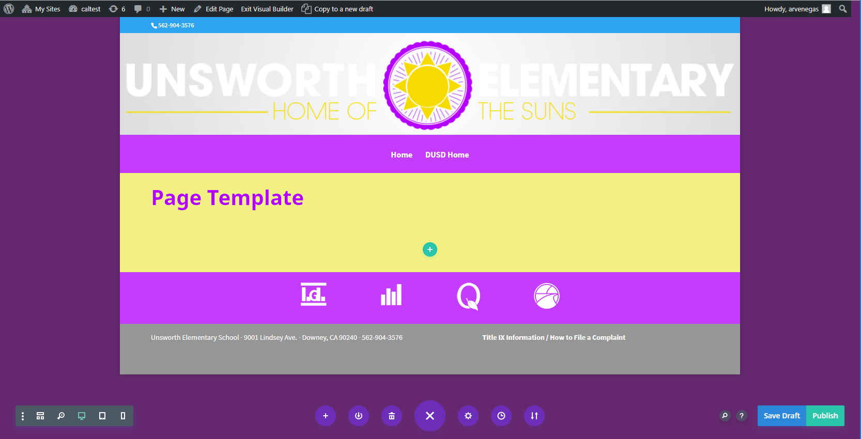
This is your page template. We are going to create a “Principal’s Message” page so it will be simple text.
First, let’s update the title. We will change it from “Page Template” to “Principal’s Message”. There are two ways to do this.

Slide 7
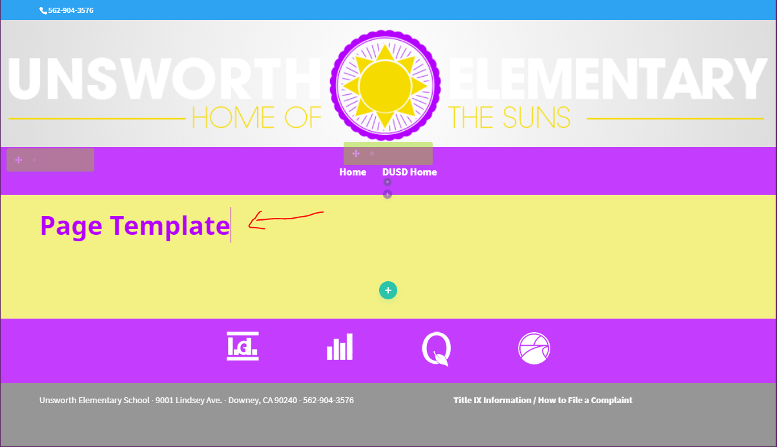
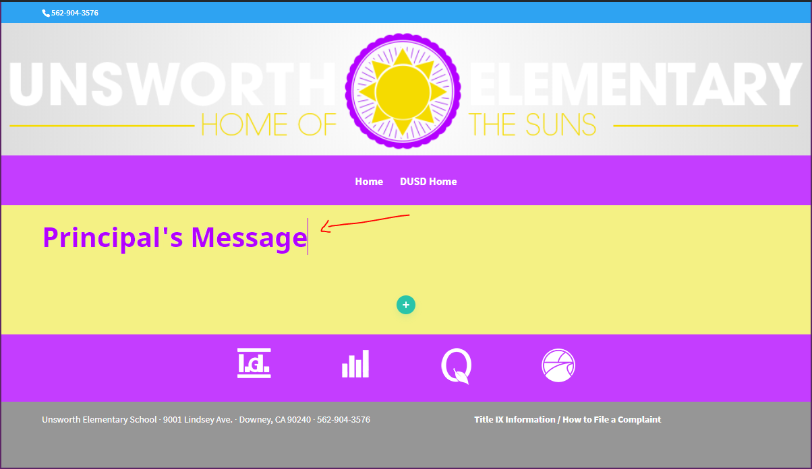
1. Click inside the area where “Page Template” is displayed and you should activate the editor. Here simply delete the Text that is displayed and start typing the desired text.

Slide 8
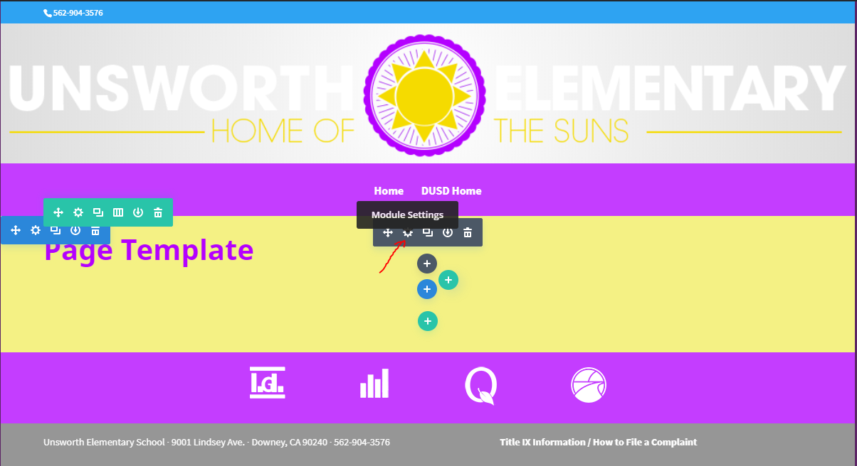
2. The other way is to hover your mouse over the area where “Page Template” is displayed and click the little gear icon that says Module Settings.

Slide 9
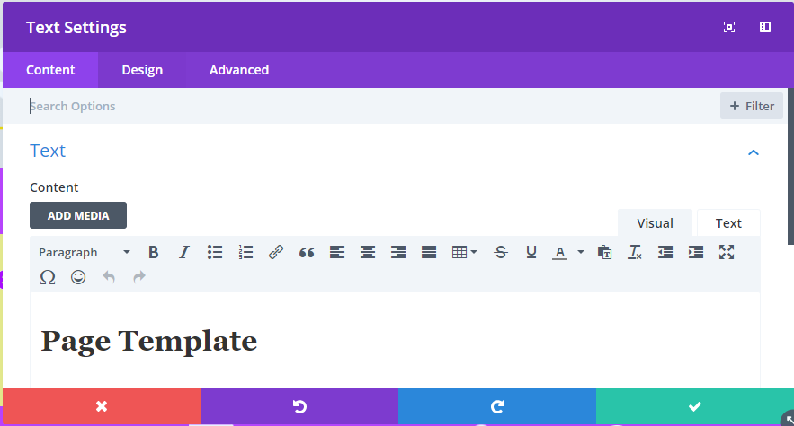
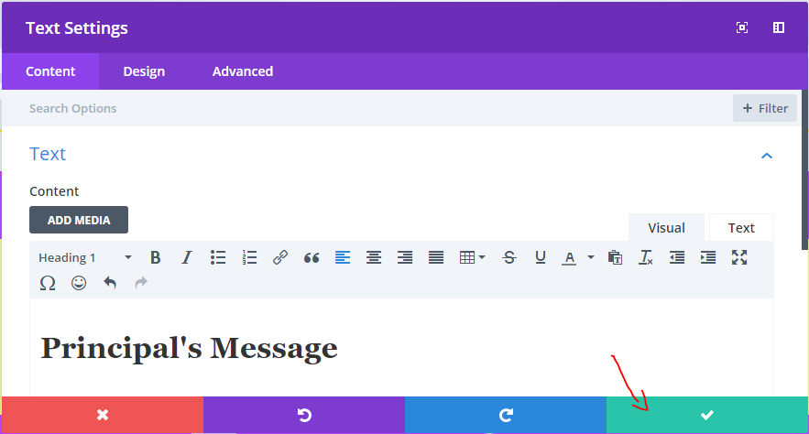
You will see this pop-up box – which gives us a more traditional editor. Delete “Page Template” and type your desired text. After you are done click the green check mark at the bottom left.

Slide 10
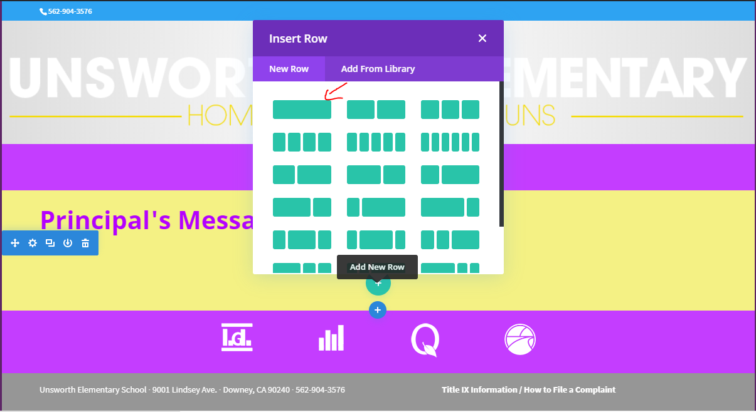
Now, to actually add content to the page. Click on the green “Plus” (+) icon and choose a row style. Since we are only adding text the first style (upper left) should be fine.

Slide 11
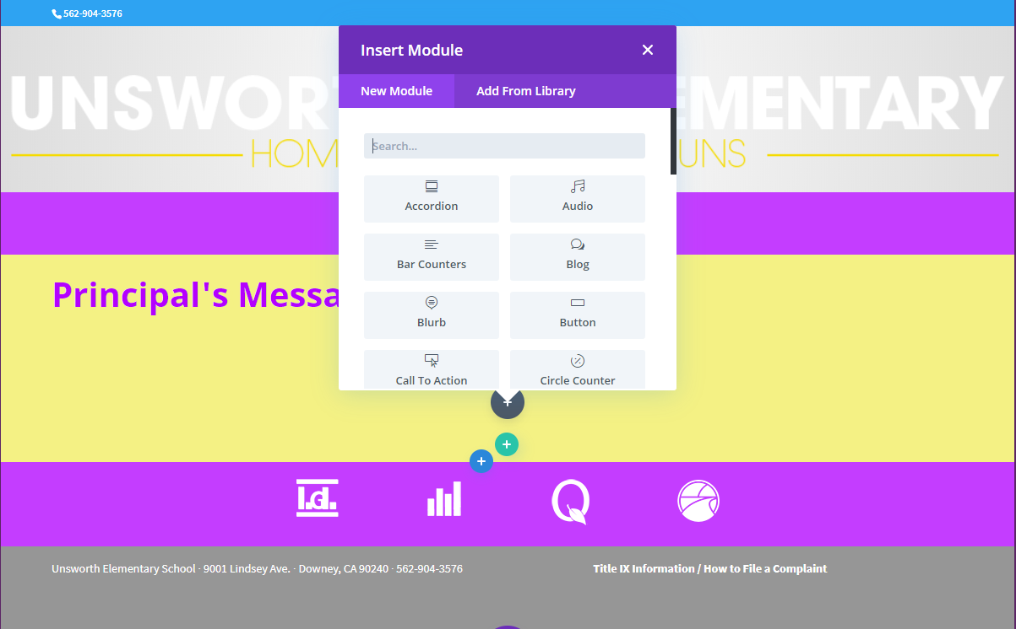
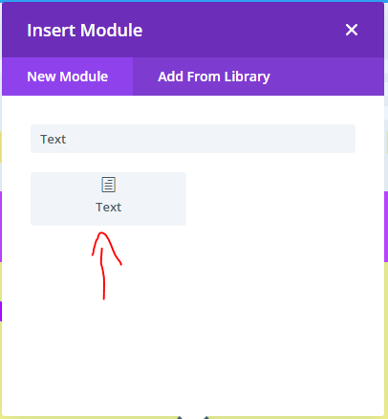
Next, you will need to choose a module. Since we are only adding text we can search or look for the “Text” module. Click on the “Text” module.

Slide 12
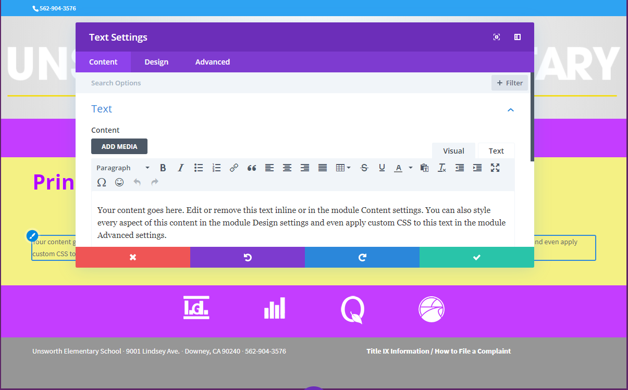
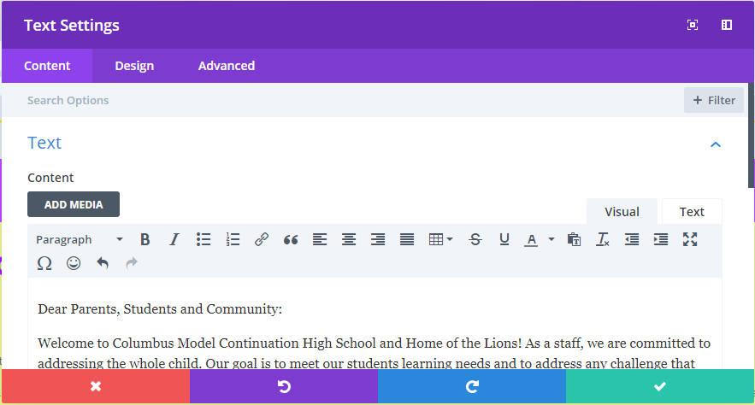
Next, the text editor will automatically pop up and you should be able to draft up your content (make sure to delete the default text) or even copy and paste text content. Once you are done click the green check mark on the bottom left.

Slide 13
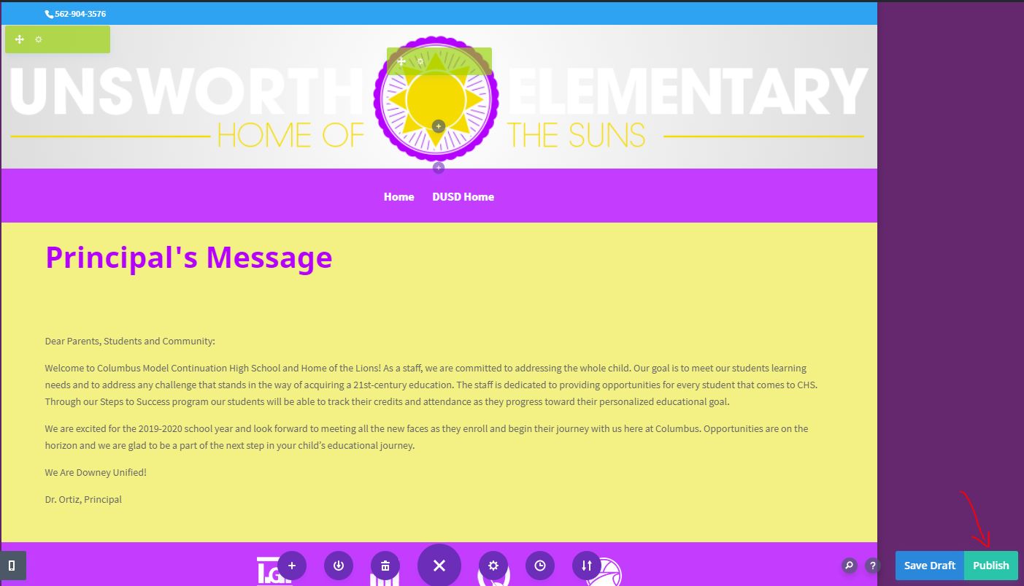
Once you are done. Click on “Publish” from the bottom left.

Slide 14
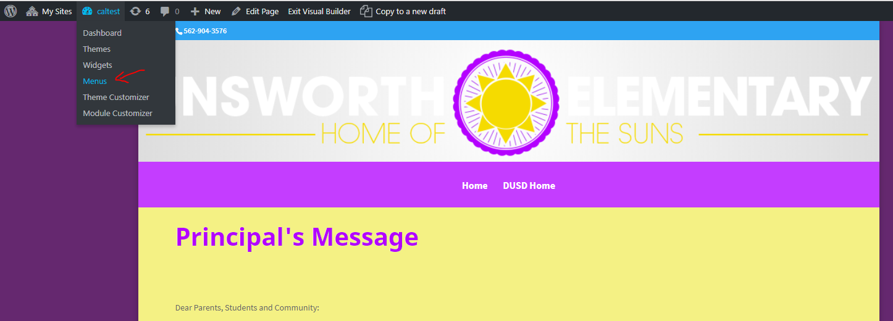
To actually add that page to your site and make it visible to the public, we need to add it to the navigation menu. Click on the site name on the upper admin tools bar (in this instance the site it named “caltest”. Then click on “Menus”

Slide 15
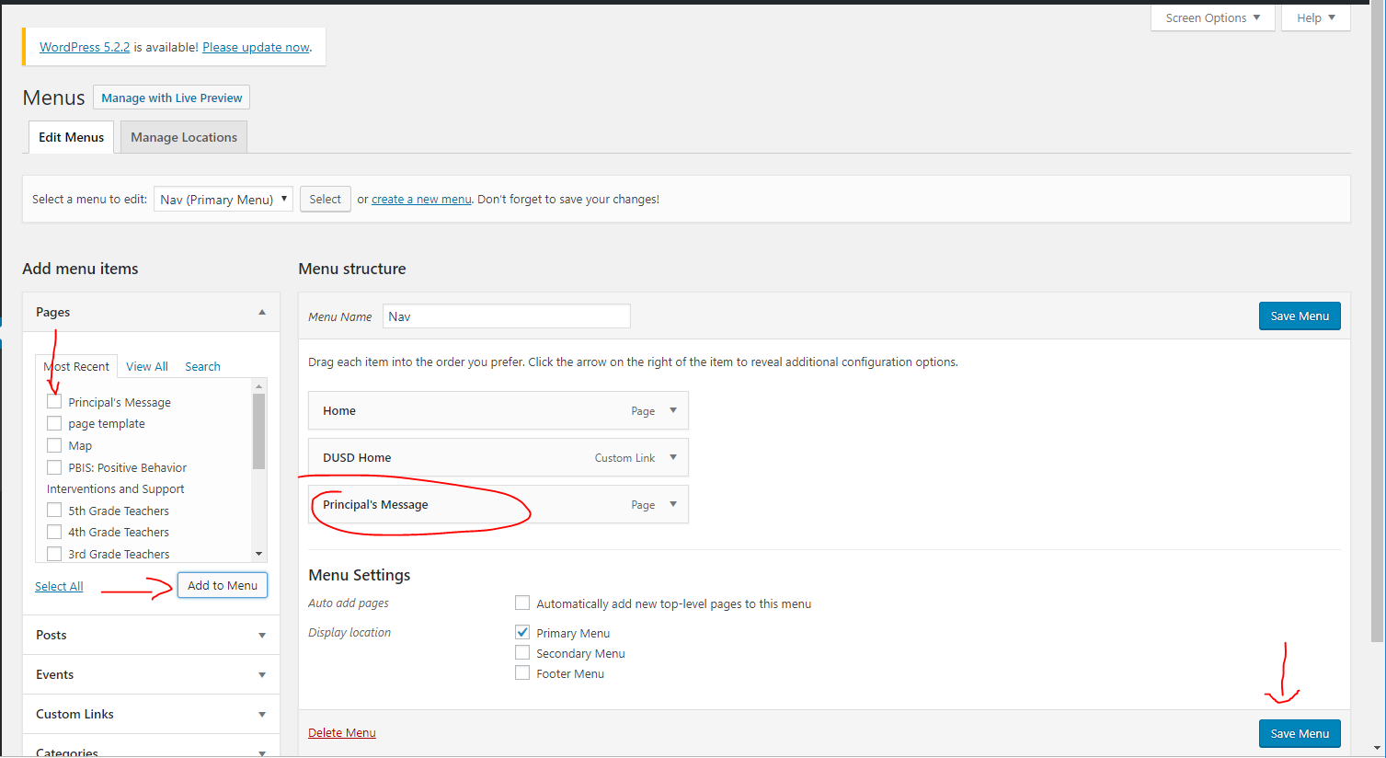
Here, check the page you created then click on “Add to Menu”. Once it is added click on “Save Menu”

