Slide 2
About Cerritos Complete
A California College Promise program
Focuses on the student’s pledge to complete their degrees or certificates on time
Two-year program for students meeting requirements
Available to graduating high school seniors or adults completing equivalency in our partner districts
Nationally Recognized for accelerating Student Success
www.cerritos.edu/cerritoscomplete

Slide 3
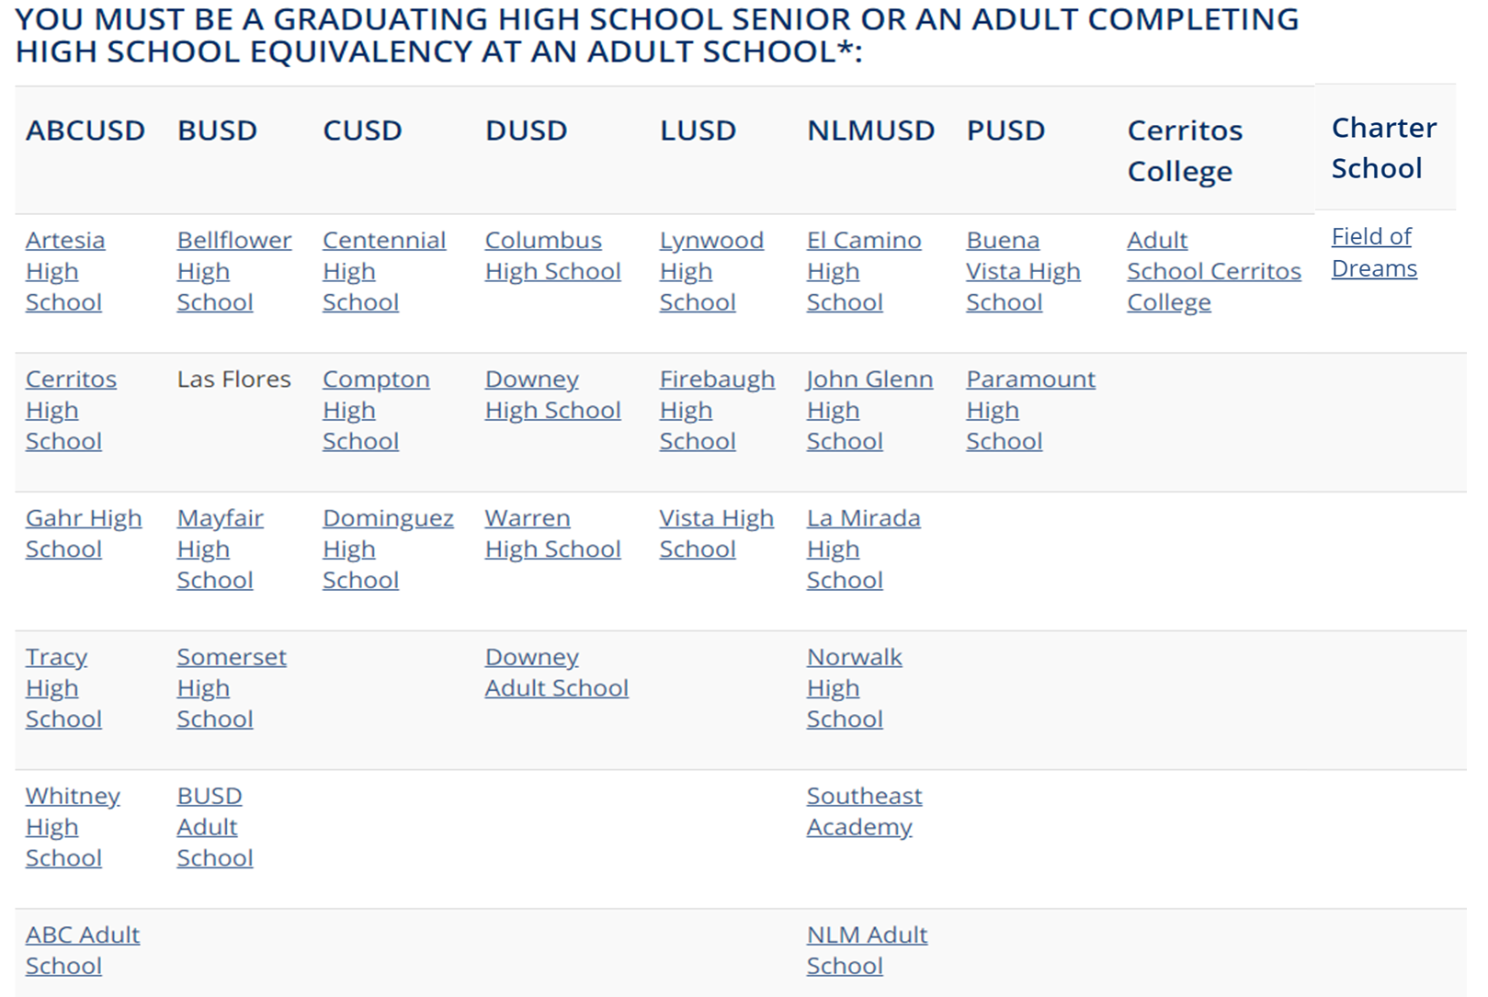
Partner School Districts
www.cerritos.edu/cerritoscomplete

Slide 4
Cerritos Complete Benefits
2 years free tuition *in-state rates & certain fees
2 years priority enrollment
Step by step assistance
One-on-one counseling
College preparedness and career exploration
Counseling classes
Personalized educational plans
www.cerritos.edu/cerritoscomplete

Slide 5
Cerritos Complete: 5 Eligibility Steps*
1 – Submit a Cerritos College Summer 2021 Application – October 1, 2020-February 26, 2021
3 – Submit a Cerritos Complete Promise Program Intent Form – October 5, 2020-March 2, 2021
4 – Submit the Placement (Self-Report Tool) forms – February 1-May 15, 2021
5 – (A) Sign-up and complete a Falcon Edge Orientation Workshop & the 30-minute counseling appointment – Sign-ups will be in May 2021 and Workshops start June 4, 2021 (B) Enroll in classes in your MyCerritos account – You can enroll once you complete the Orientation
Get ahead on your 1st Year Requirement! Enroll in a Counseling Class (COUN 101B) in Summer 2021. *All steps and dates are subject to change. Check our website for the latest updates.
2 – (A) Submit a FAFSA or DREAM Act application for 2021-2022 – October 1, 2020-March 2, 2021 (B) Submit all additional paperwork to Cerritos College Financial Aid – April 30, 2021
www.cerritos.edu/cerritoscomplete

Slide 6
Contact Us
Jose Cortez Site Bridging Liaison Jcortez@cerritos.edu Work Cell: (562) 5036592
YouCanBookMe link
https://jose-cortez.youcanbook.me/
www.cerritos.edu/cerritoscomplete

